Slide 1
Introduction to Meta-Analysis
Sudeep Sharma
University of Illinois at Springfield
Hamed Qahri-Saremi
DePaul University

Slide 2
Overview of the Workshop
Topics that we will address
  Review of the basic procedural steps
    Problem definition
    Document Retrieval
    Coding
    Effect sizes and computation
    Analysis of effect sizes
    Publication Bias
  Cutting edge issues
  Interpretation of results
  Evaluating the quality of a meta-analysis
Notes:
If time permits

Slide 3
The Great Debate
1952: Hans J. Eysenck concluded that there were no favorable effects of psychotherapy, starting a raging debate
20 years of evaluation research and hundreds of studies failed to resolve the debate
1978: To proved Eysenck wrong, Gene V. Glass statistically aggregate the findings of 375 psychotherapy outcome studies
Glass (and colleague Smith) concluded that psychotherapy did indeed work
Glass called his method “meta-analysis”

Slide 4
The Emergence of Meta-analysis
Ideas behind meta-analysis predate Glass’ work by several decades
  Karl Pearson (1904)
    averaged correlations for studies of the effectiveness of inoculation for typhoid fever
  R. A. Fisher (1944)
    “When a number of quite independent tests of significance have been made, it sometimes happens that although few or none can be claimed individually as significant, yet the aggregate gives an impression that the probabilities are on the whole lower than would often have been obtained by chance” (p. 99).
    Source of the idea of cumulating probability values

Slide 5
The Emergence of Meta-analysis
Ideas behind meta-analysis predate Glass’ work by several decades
  W. G. Cochran (1953)
    Discusses a method of averaging means across independent studies
    Laid-out much of the statistical foundation that modern meta-analysis is built upon (e.g., Inverse variance weighting and homogeneity testing)

Slide 6
The Logic of Meta-analysis
Traditional methods of review focus on statistical significance testing
Significance testing is not well suited to this task
  Highly dependent on sample size
  Null finding does not carry the same “weight” as a significant finding
    significant effect is a strong conclusion
    nonsignificant effect is a weak conclusion
Meta-analysis focuses on the direction and magnitude of the effects across studies, not statistical significance
  Isn’t this what we are interested in anyway?
  Direction and magnitude are represented by the effect size

Slide 7
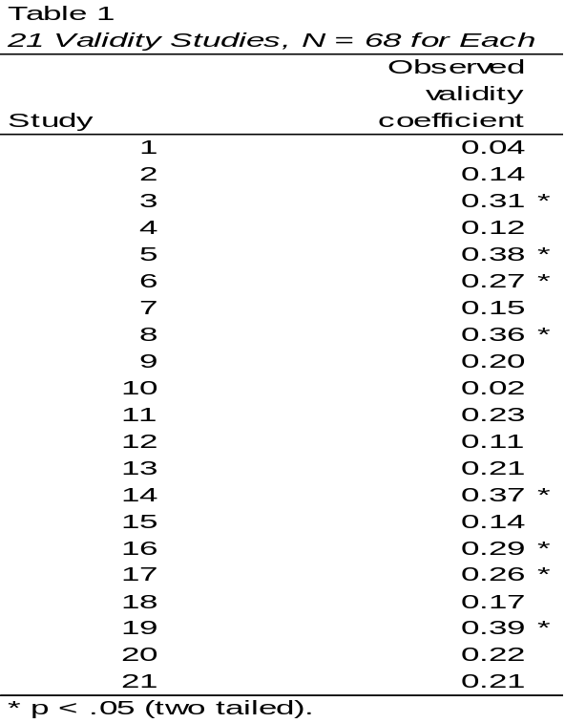
Illustration
Simulated data from 21 validity studies. Taken from: Schimdt, F. L. (1996). Statistical significance testing and cumulative knowledge in psychology: implications for training of researchers. Psychological Methods, 1, 115-129.

Slide 8
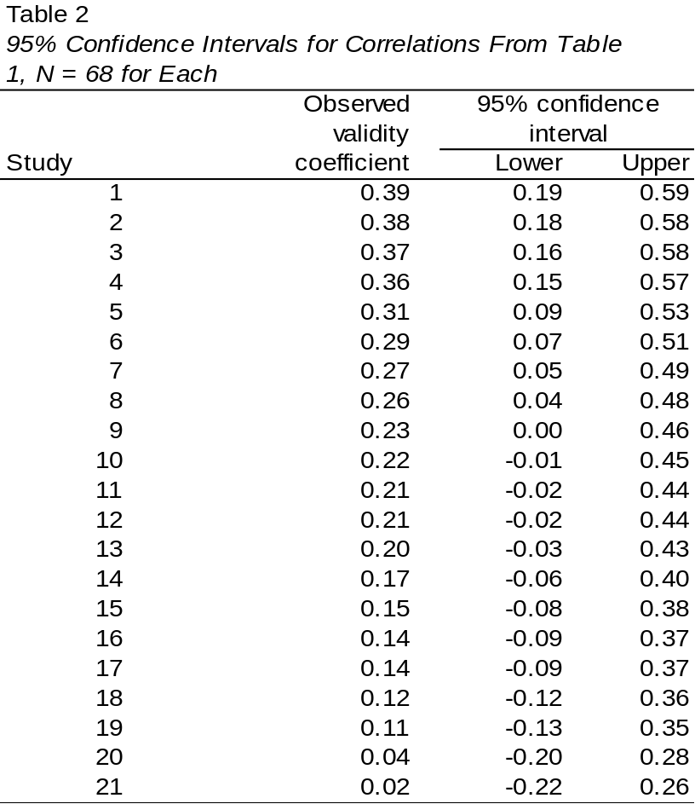
Illustration (Continued)

Slide 9
When Can You Do Meta-analysis?
Meta-analysis is applicable to collections of research that
  Are empirical, rather than theoretical
  Produce quantitative results, rather than qualitative findings
  Examine the same constructs and relationships
  Have findings that can be configured in a comparable statistical form (e.g., as effect sizes, correlation coefficients, odds-ratios, proportions)
  Are “comparable” given the question at hand

Slide 10
Forms of Research Findings Suitable to Meta-analysis
Central tendency research
  Prevalence rates
Pre-post contrasts
  Growth rates
Group contrasts
  Experimentally created groups
    Comparison of outcomes between treatment and comparison groups
  Naturally occurring groups
    Comparison of spatial abilities between boys and girls
    Rates of morbidity among high and low risk groups

Slide 11
Forms of Research Findings Suitable to Meta-analysis
Association between variables
  Measurement research
    Validity generalization
  Individual differences research
    Correlation between personality constructs

Slide 12
Basic Steps in a Meta-Analysis
Literature Search
Coding the variable
Data analysis-Main effects
Data analysis-Moderating effects
Presentation

Slide 13
Which Studies to Include?
It is critical to have an explicit inclusion and exclusion criteria
  The broader the research domain, the more detailed they tend to become
  Refine criteria as you interact with the literature
  Components of a detailed criteria
    distinguishing features
    research respondents
    key variables
    research methods
    cultural and linguistic range
    time frame
    publication types

Slide 14
Methodological Quality Dilemma
Include or exclude low quality studies?
  The findings of all studies are potentially in error (methodological quality is a continuum, not a dichotomy)
  Being too restrictive may restrict ability to generalize
  Being too inclusive may weaken the confidence that can be placed in the findings
  Methodological quality is often in the “eye-of-the-beholder”
  You must strike a balance that is appropriate to your research question

Slide 15
Searching Far and Wide
The “we only included published studies because they have been peer-reviewed” argument
Significant findings are more likely to be published than nonsignificant findings
Critical to try to identify and retrieve all studies that meet your eligibility criteria

Slide 16
Searching Far and Wide (continued)
Potential sources for identification of documents
  Computerized bibliographic databases
  “Google” internet search engine
  Authors working in the research domain (email a relevant Listserv?)
  Conference programs
  Dissertations
  Review articles
  Hand searching relevant journal
  Government reports, bibliographies, clearinghouses

Slide 17
A Note About Computerized Bibliographies
Rapidly changing area
Get to know your local librarian!
Searching one or two databases is generally inadequate
Use “wild cards” (e.g., random? will find random, randomization, and randomize)
Throw a wide net; filter down with a manual reading of the abstracts

Slide 18
Coding Studies
The steps of a good coding procedure are
Decide which characteristics you want to code.
Decide exactly how you will measure each characteristic. If you decide to use a continuous scale, specify the units. If you decide to use categories, specify what groups you will use.
Write down the specifics of your coding scheme in a code book. The code book should contain explicit instructions on how to code each characteristic, including specific examples where necessary.

Slide 19
Coding….Continue
Pilot the coding scheme and train the coders. You should probably code 2-4 studies between training sessions.
Once you have a stable coding scheme you code the studies. The coders should work independently, with only occasional meetings to correct ambiguities in the scheme.
Calculate the reliability of the coding for each item in your scheme. You should not include the studies you used for training in your calculation of reliability.

Slide 20
What to code…….
Selection of Moderators
  Major methodological variations.
  Theoretical constructs.
  Basic study characteristics.

Slide 21
Effect Size: The Key to Meta-analysis
The effect size makes meta-analysis possible
  It is the “dependent variable”
  It standardizes findings across studies such that they can be directly compared

Slide 22
Effect Size: The Key to Meta-analysis
Any standardized index can be an “effect size” (e.g., standardized mean difference, correlation coefficient, odds-ratio) as long as it meets the following
  Is comparable across studies (generally requires standardization)
  Represents the magnitude and direction of the relationship of interest
  Is independent of sample size
Different meta-analyses may use different effect size indices

Slide 23
The Effect Size
The effect size (ES) makes meta-analysis possible
The ES encodes the selected research findings on a numeric scale
There are many different types of ES measures, each suited to different research situations
Each ES type may also have multiple methods of computation

Slide 24
Examples of Different Types of Effect Sizes
Standardized mean difference
  Group contrast research
    Treatment groups
    Naturally occurring groups
  Inherently continuous construct
Odds-ratio
  Group contrast research
    Treatment groups
    Naturally occurring groups
  Inherently dichotomous construct
Correlation coefficient
  Association between variables research

Slide 25
Examples of Different Types of Effect Sizes
Risk ratio
  Group differences research (naturally occurring groups)
  Commonly used by epidemiologist and medical meta-analyses
  Inherently dichotomous construct
  Easier to interpret than the odds-ratio

Slide 26
What Makes Something an Effect Size for Meta-analytic Purposes
The type of ES must be comparable across the collection of studies of interest
This is generally accomplished through standardization
Must be able to calculate a standard error for that type of ES
  The standard error is needed to calculate the ES weights, called inverse variance weights (more on this latter)
  All meta-analytic analyses are weighted

Slide 27
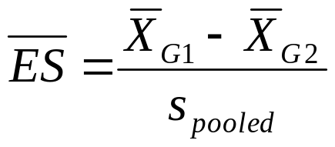
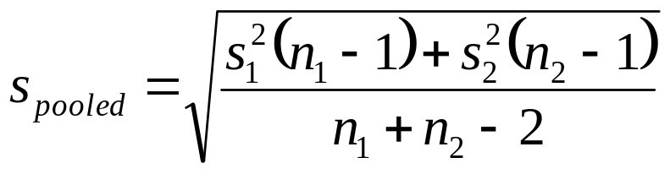
The Standardized Mean Difference
Represents a standardized group contrast on an inherently continuous measure
Uses the pooled standard deviation (some situations use control group standard deviation)
Commonly called “d” or occasionally “g”

Slide 28

The Correlation Coefficient
Represents the strength of association between two inherently continuous measures
Generally reported directly as “r” (the Pearson product moment coefficient)

Slide 29
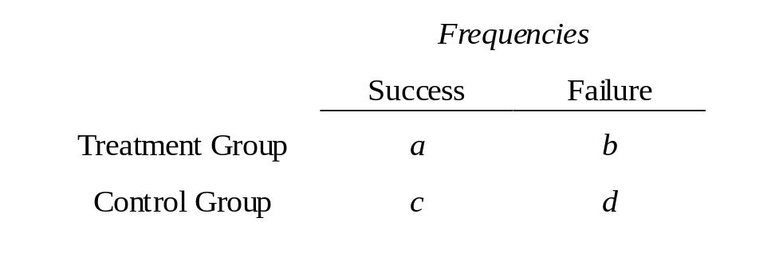
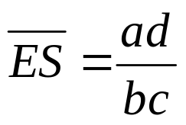
The Odds-Ratio
The odds-ratio is based on a 2 by 2 contingency table, such as the one below
The Odds-Ratio is the odds of success in the treatment group relative to the odds of success in the control group.

Slide 30
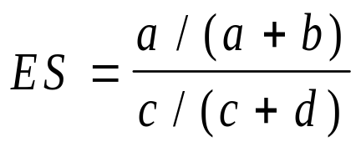
The Risk Ratio
The risk ratio is also based on data from a 2 by 2 contingency table, and is the ratio of the probability of success (or failure) for each group

Slide 31
Formulas for the Correlation Coefficient
Results typically reported directly as a correlation
Any data for which you can calculate a standardized mean difference effect size, you can also calculate a correlation type effect size
See Rosenthal (1991) book/paper for formulas

Slide 32
Issues in Coding Effect Sizes
Which formula to use when data are available for multiple formulas
Multiple documents/publications reporting the same data (not always in agreement)
How much guessing should be allowed
  sample size is important but may not be presented for both groups
  some numbers matter more than others

Slide 33
Strengths of Meta-analysis
Imposes a discipline on the process of summing up research findings
Represents findings in a more differentiated and sophisticated manner than conventional reviews
Capable of finding relationships across studies that are obscured in other approaches
Protects against over-interpreting differences across studies
Can handle a large numbers of studies (this would overwhelm traditional approaches to review)

Slide 34
Weaknesses of Meta-analysis
Requires a good deal of effort
Mechanical aspects don’t lend themselves to capturing more qualitative distinctions between studies
“Apples and oranges” criticism
Most meta-analyses include “blemished” studies to one degree or another (e.g., a randomized design with attrition)
Selection bias posses a continual threat
  Negative and null finding studies that you were unable to find
  Outcomes for which there were negative or null findings that were not reported
Analysis of between study differences is fundamentally correlational

Slide 35
Major Reviews
  Thompson’s (1990) assessment that ‘‘personality and individual differences appear to play a minimal role in determining bargaining behavior’’ (p. 515).
  Bazerman, Curhan, Moore, and Valley’s (2000) claim that ‘‘simple individual differences offer limited potential for predicting negotiation outcomes’’ (p. 281).
  Unduly influenced by one major qualitative review (Rubin & Brown, 1975)- “Irrelevance Consensus”

Slide 36
Comprehensive Meta-Analysis
(Sharma, Bottom, & Elfenbein, 2013)
Straightforward benefits for intelligence
  Cognitive intelligence facilitates individual and joint economic gain
  Emotional intelligence facilitates relationship building
More complex effects for personality traits
  Modest, scatter, and inconsistent findings
  Limited number of studies
Misinterpretations of Rubin & Brown(1975) qualitative analysis hindered data gathering – impeded the field

Slide 37
Thank you!

